Slide 1
Communicating with Data – More Advanced Tableau
Dr. Ab Mosca (they/them)
Slides based off slides courtesy of Jordan Crouser (https://jcrouser.github.io/)

Slide 2
Reminder
Be prepared for prototype testing in class on Thursday!

Slide 3
Plan for Today
Working with multiple datasets
Customizing the look of a visualization
Working with filters
Conditional backgrounds
Details on demand (external resources)

Slide 4
Want to follow along?
Everything used in this demo is available in superhero-demo.zip under in-class on the course website

Slide 5
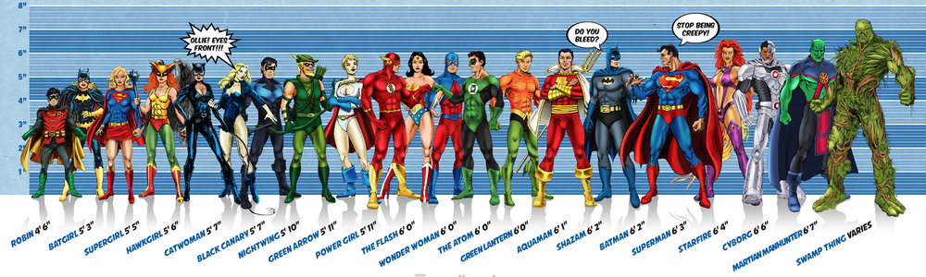
Running example: superheroes
Image credit: Ming Malaykham

Slide 6
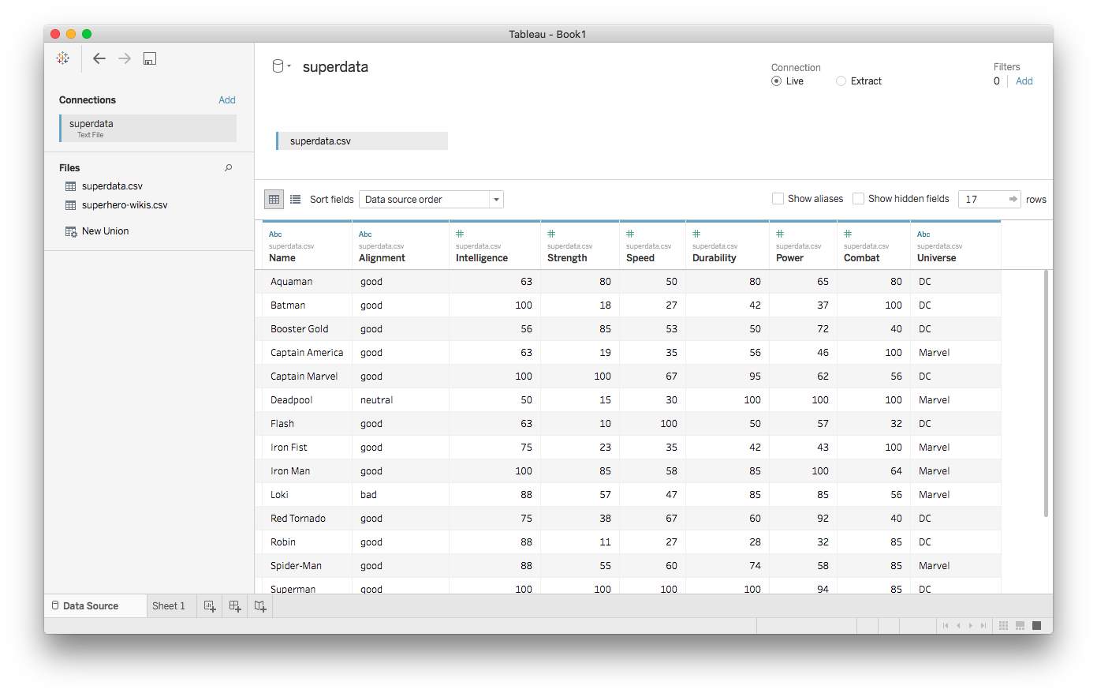
First dataset: superdata.csv

Slide 7
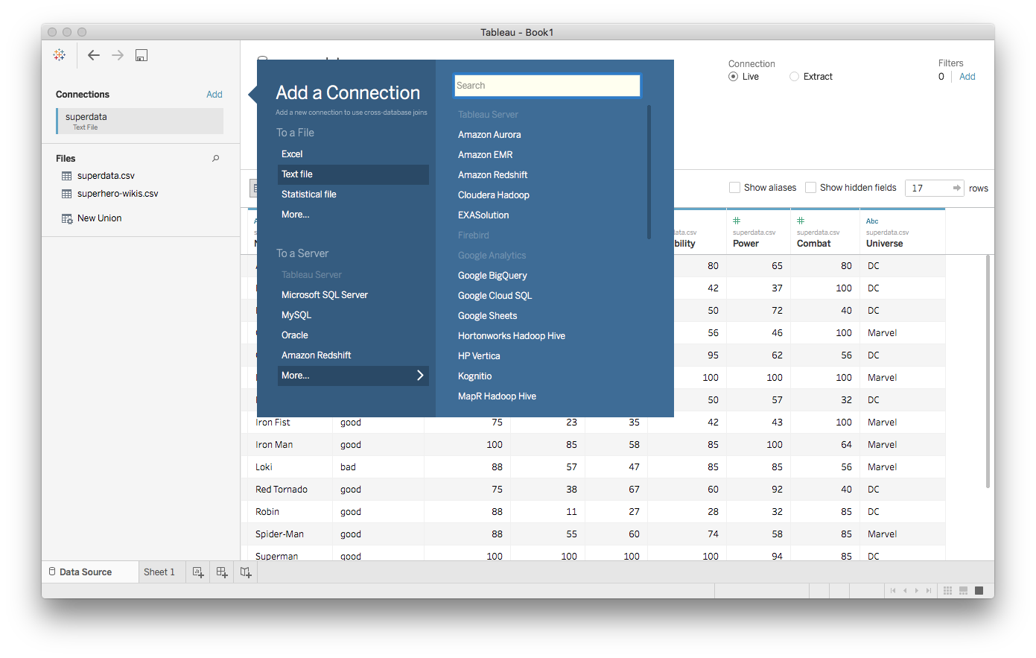
Adding more datasets

Slide 8
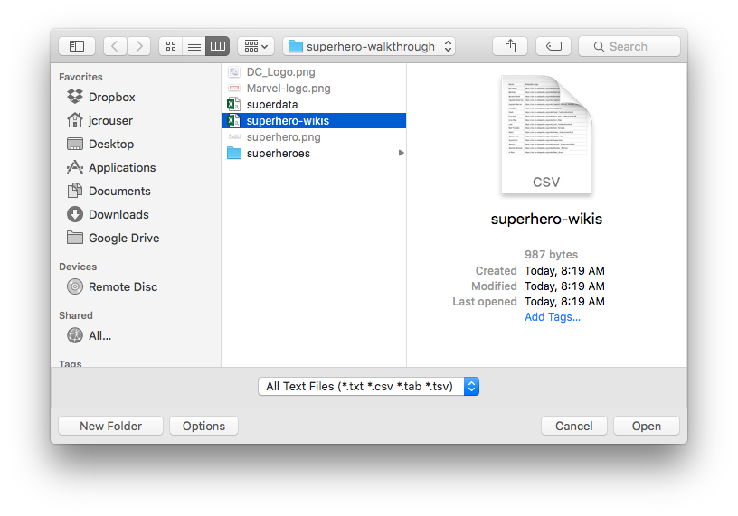
Adding more datasets

Slide 9
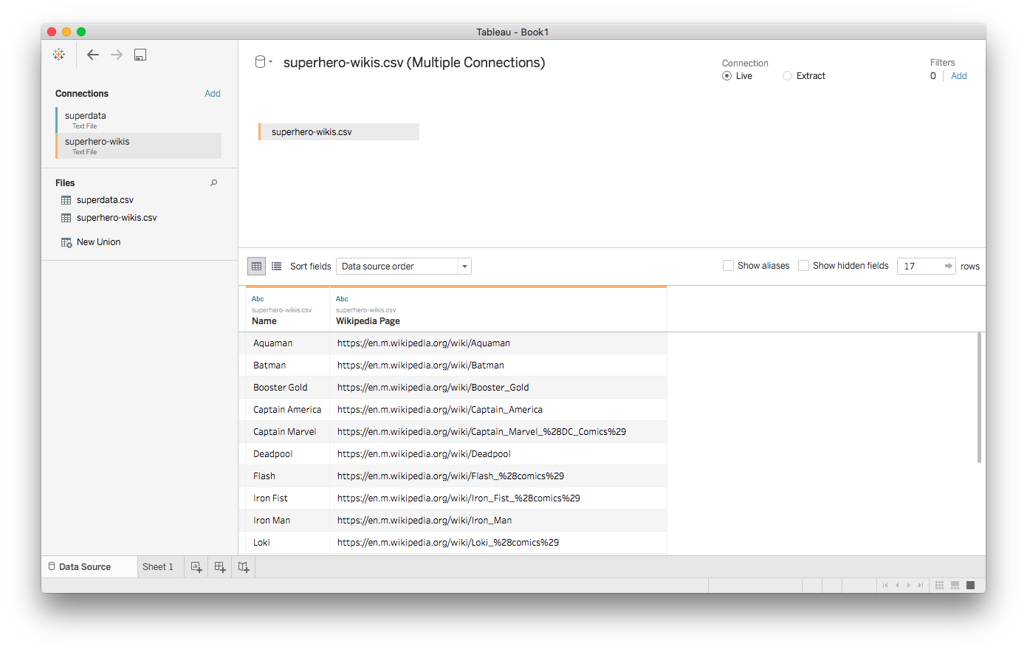
Second dataset: superhero-wikis.csv

Slide 10
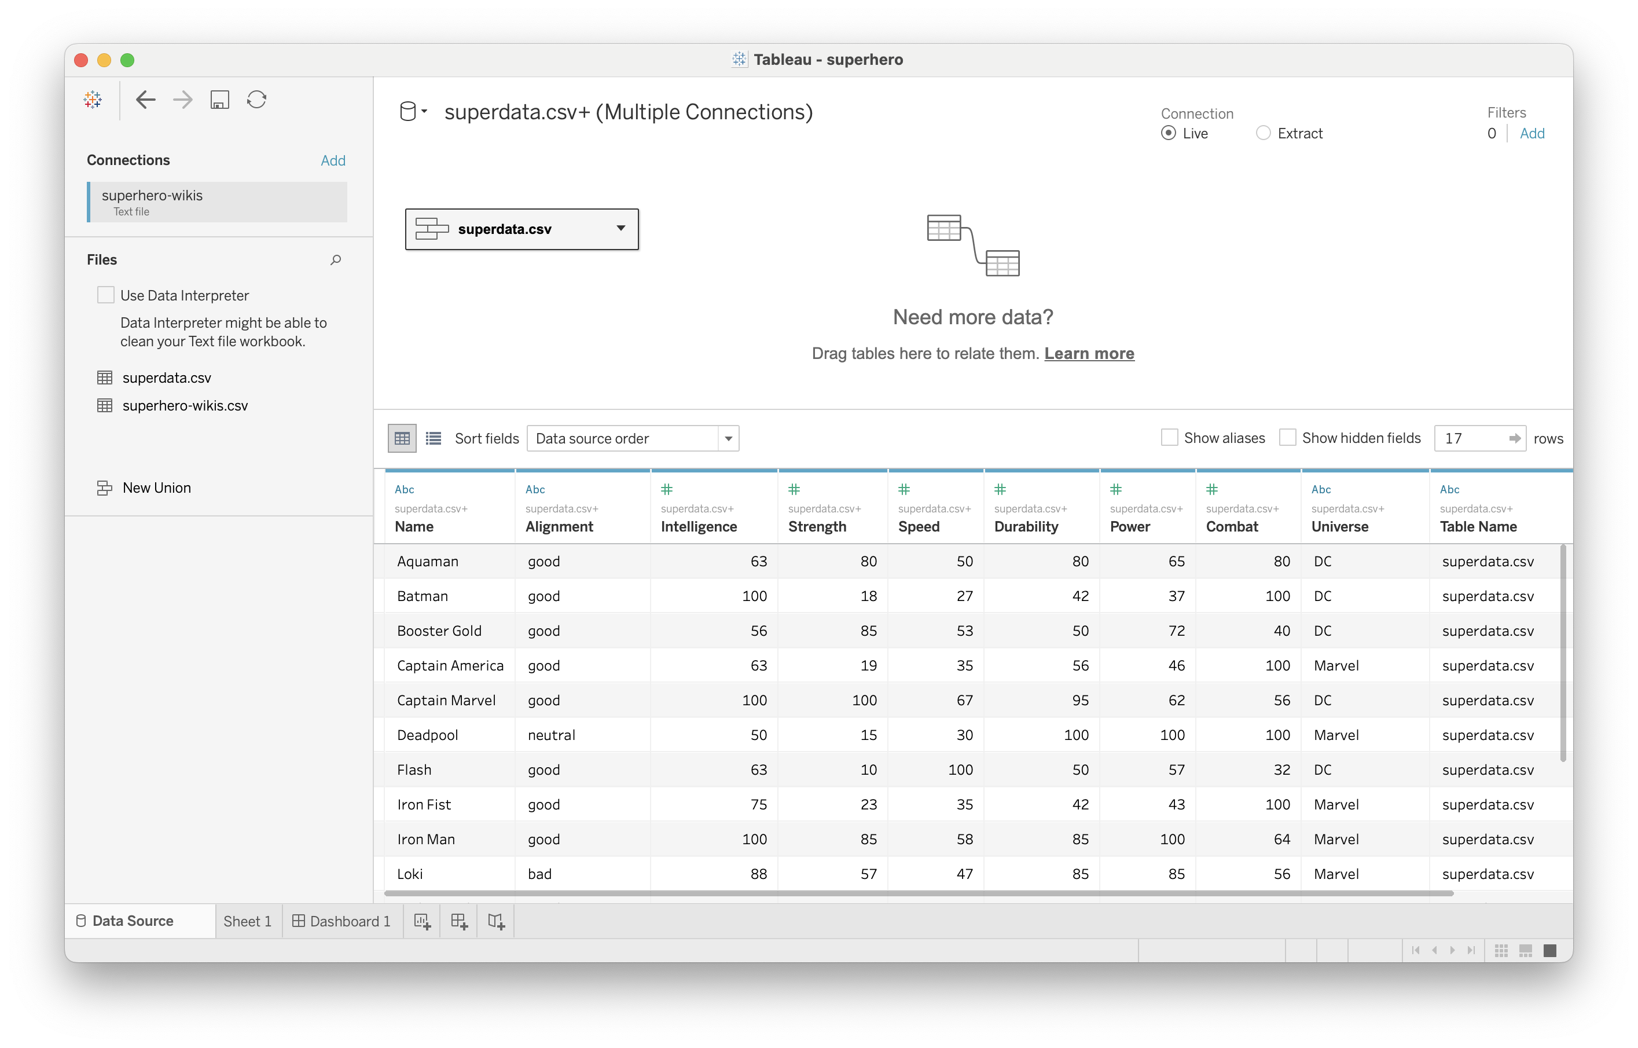
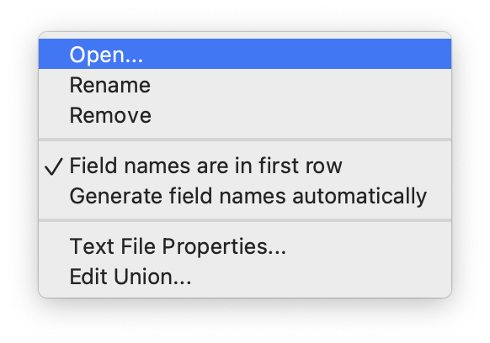
Joining the two
Notes:
Double click

Slide 11
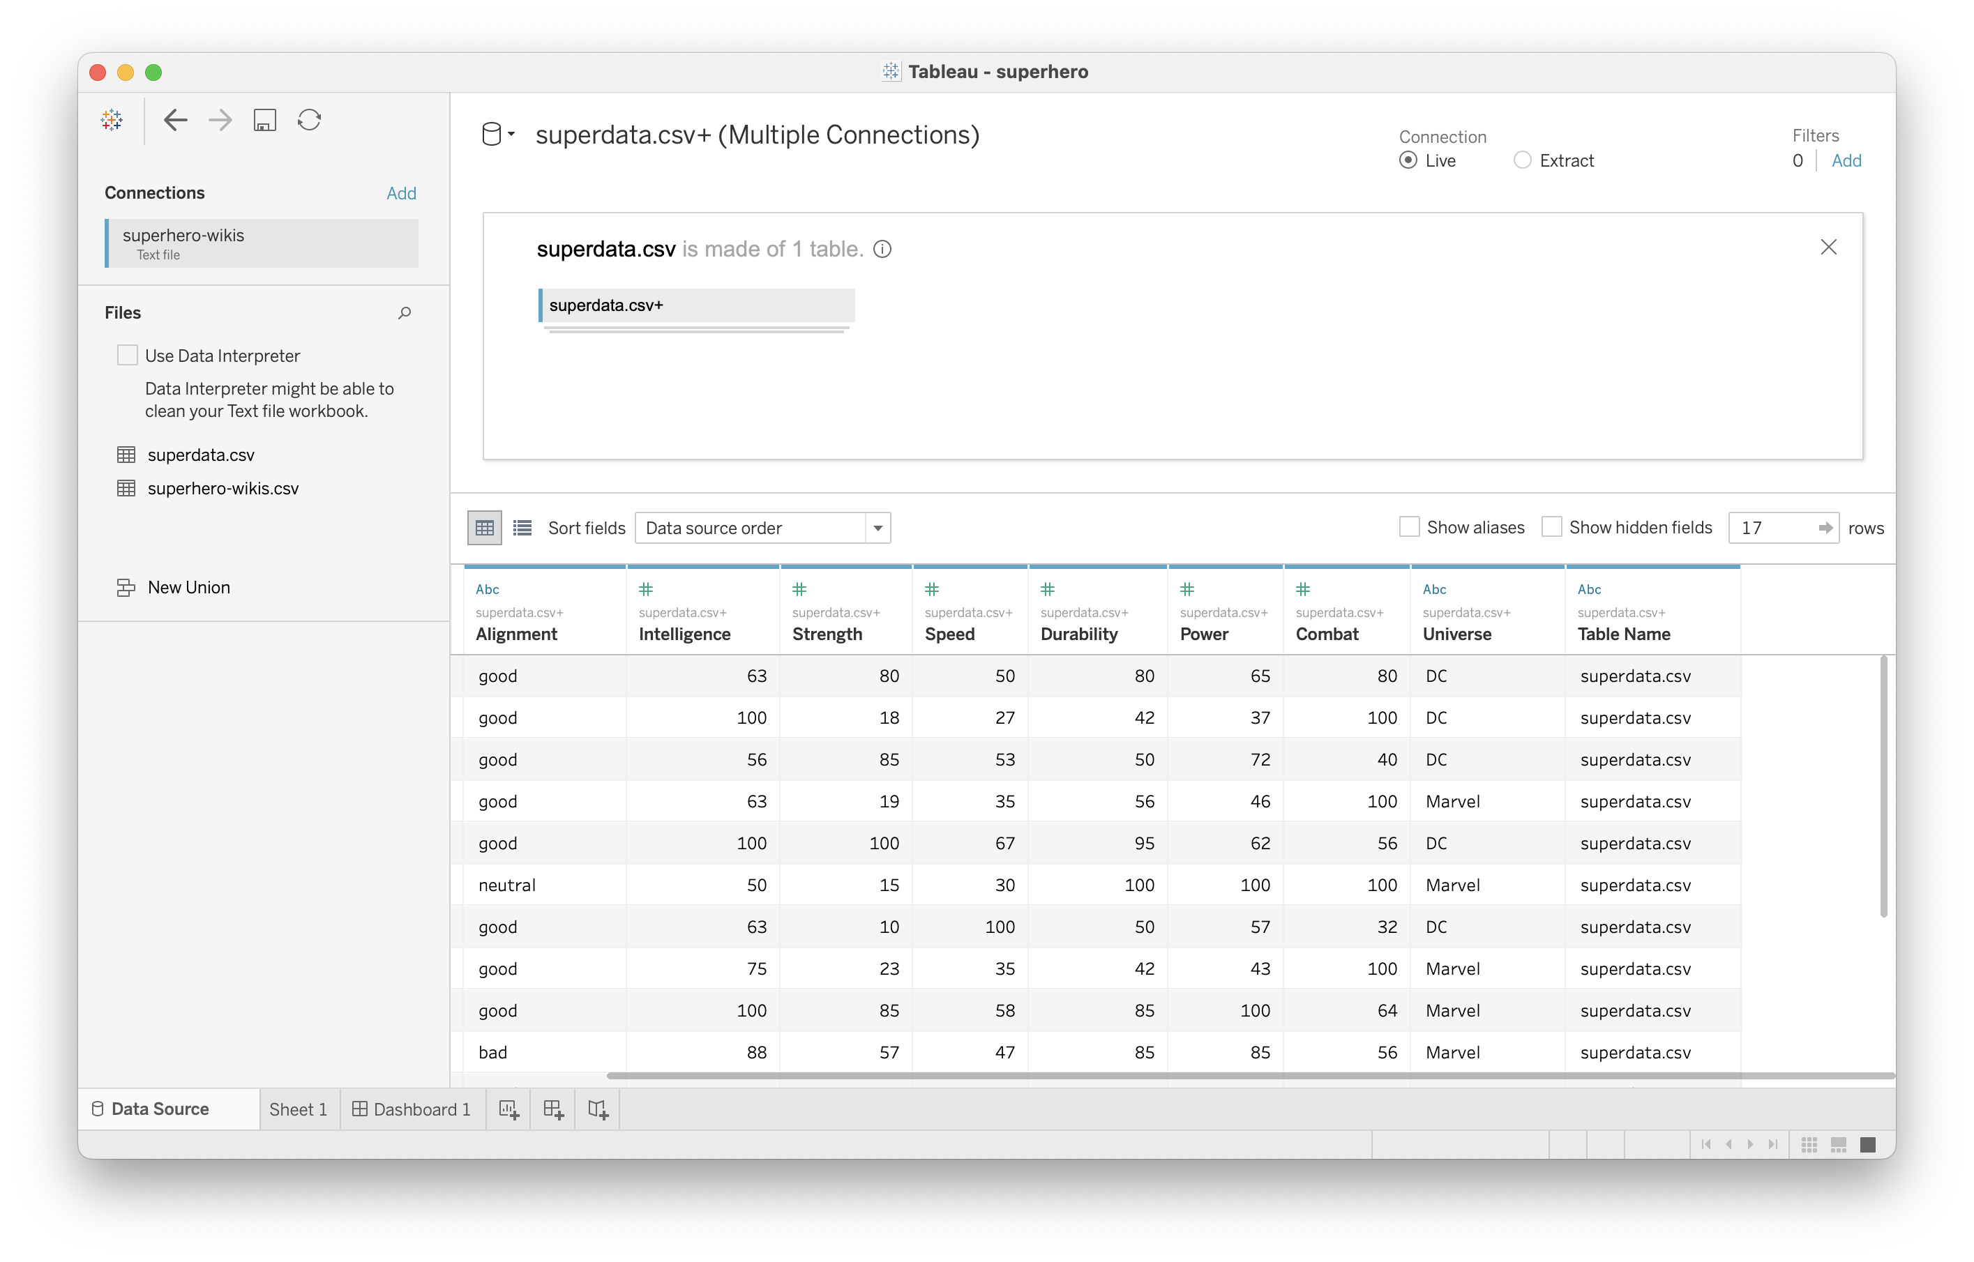
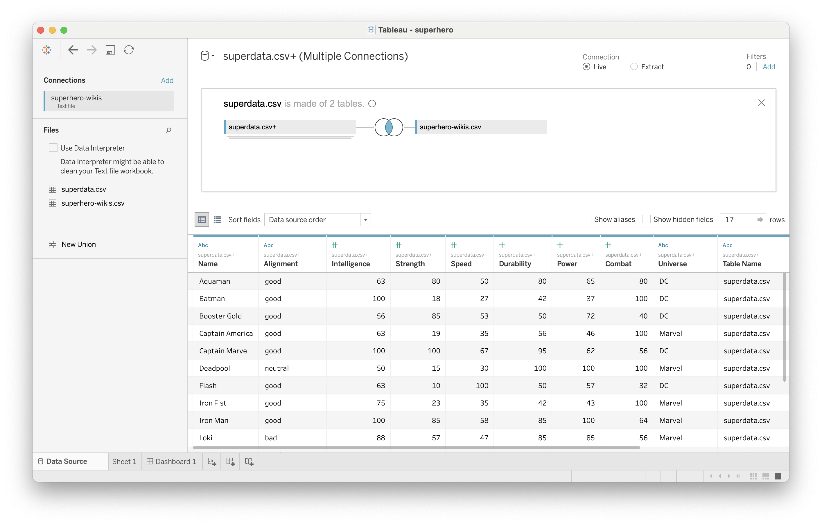
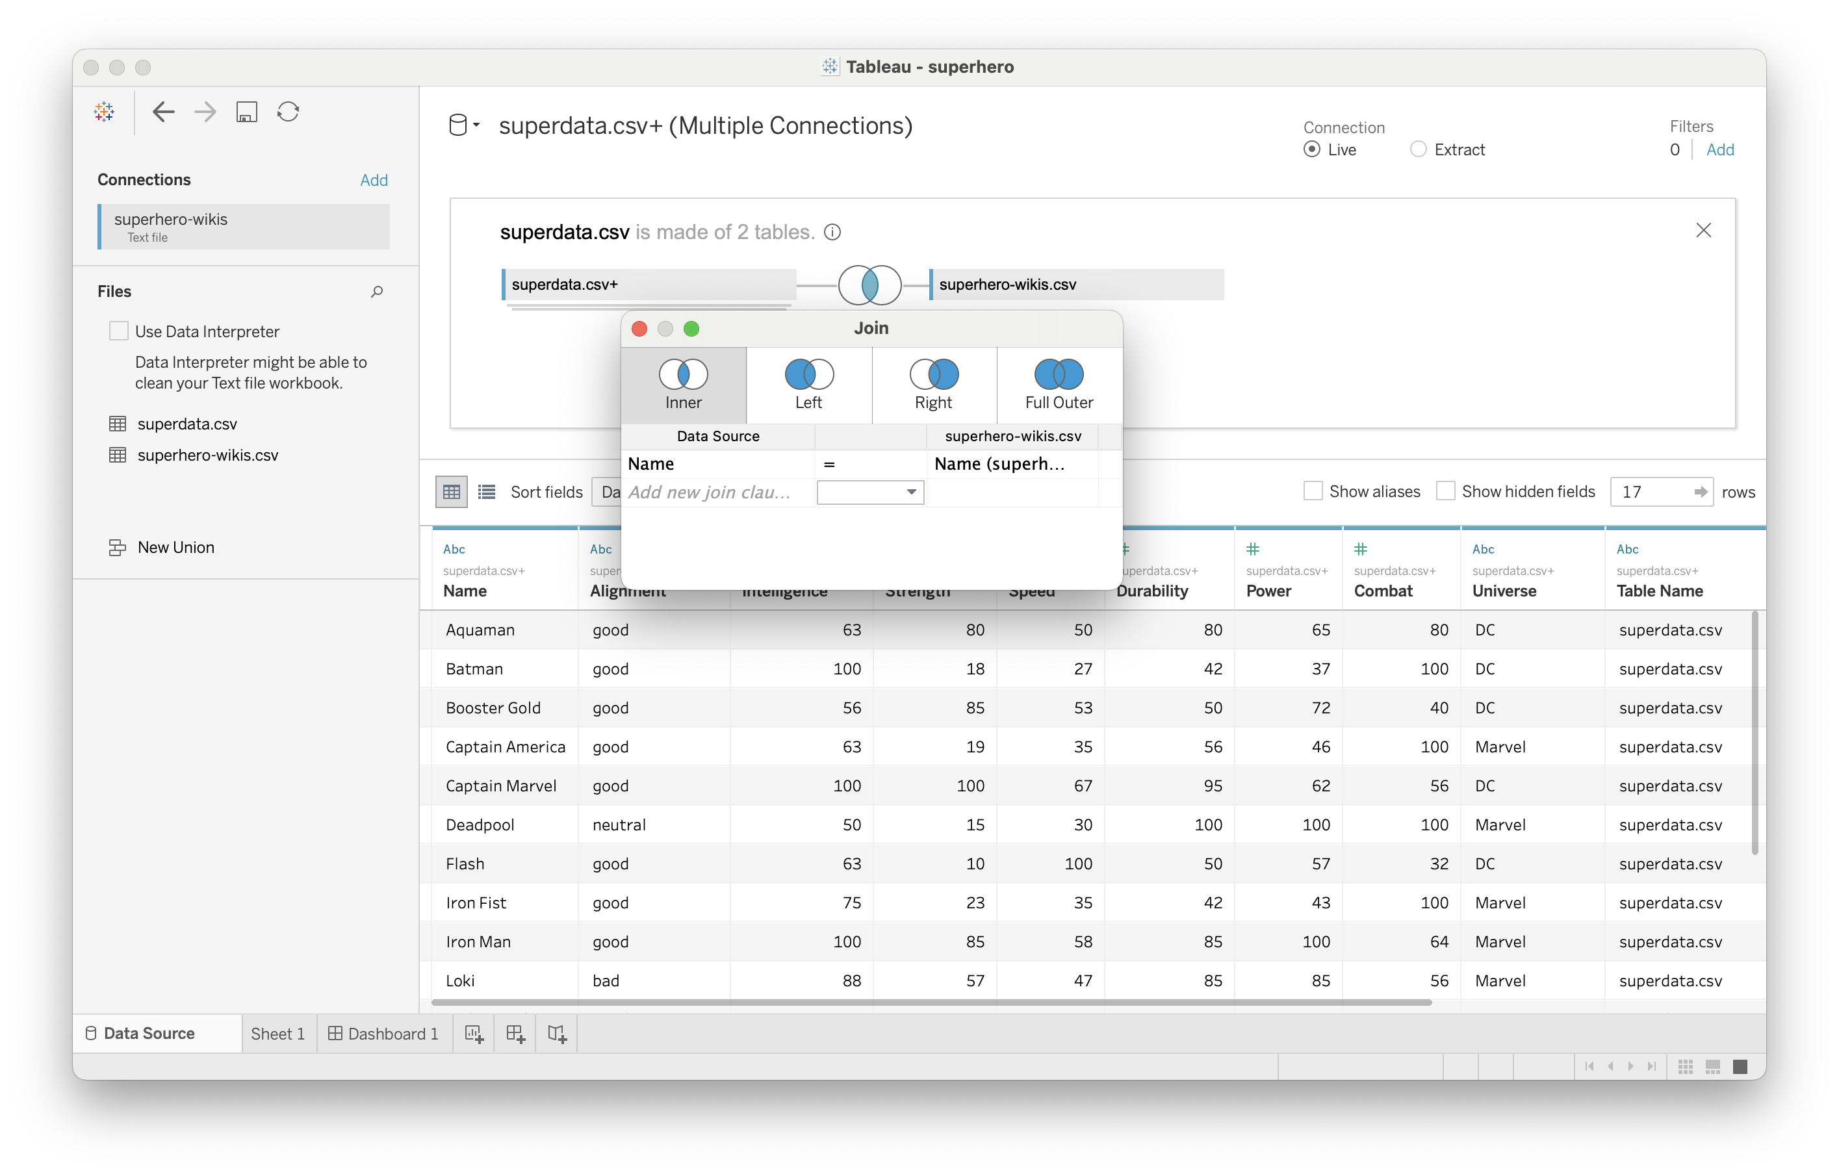
Joining the two
Notes:
Click here to edit relationship

Slide 12
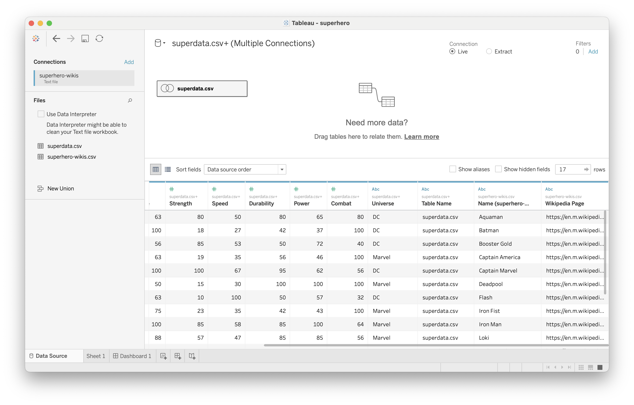
Joining the two
Notes:
Click here to edit relationship

Slide 13
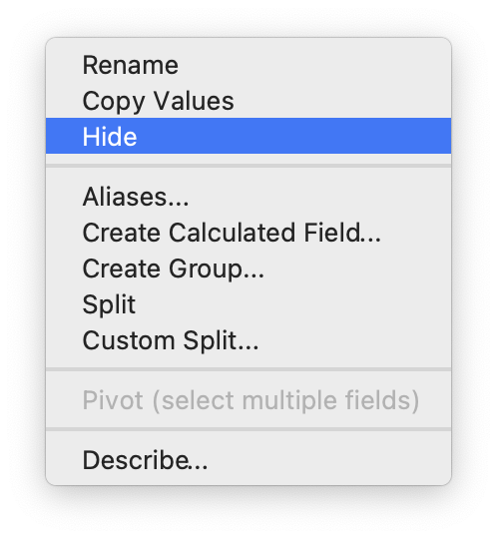
Hiding unnecessary data

Slide 14
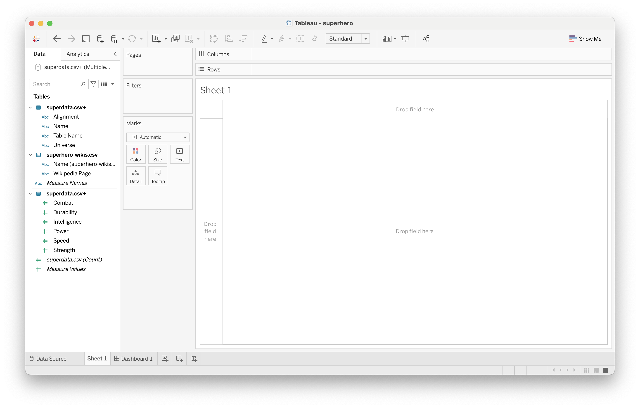
Over to Sheet1

Slide 15
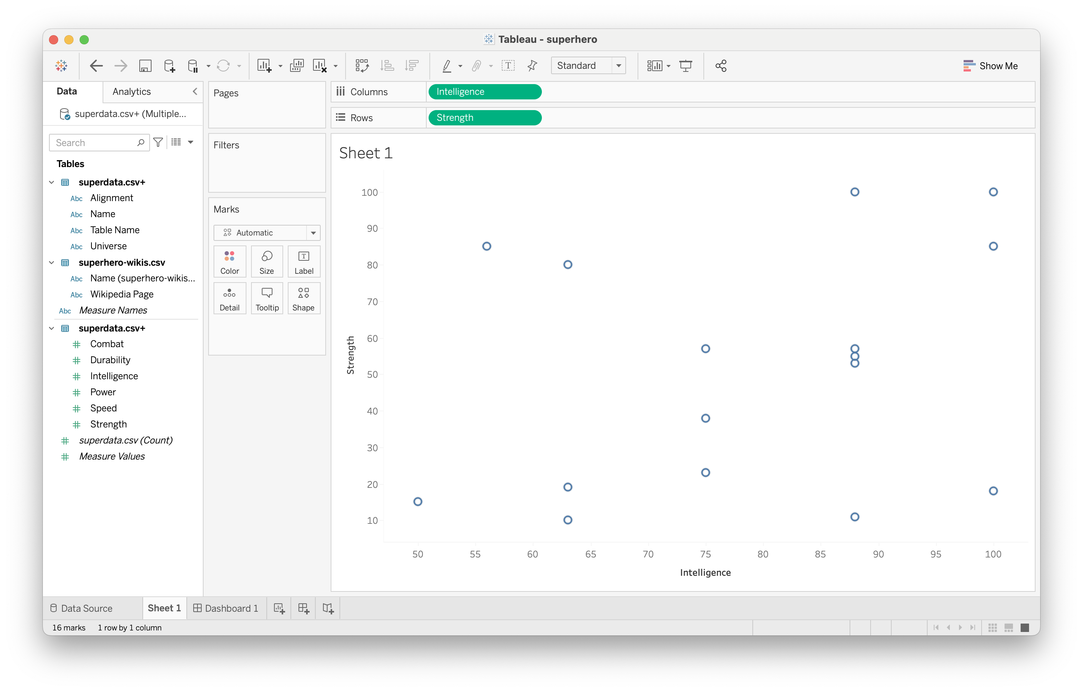
Simple scatterplot

Slide 16
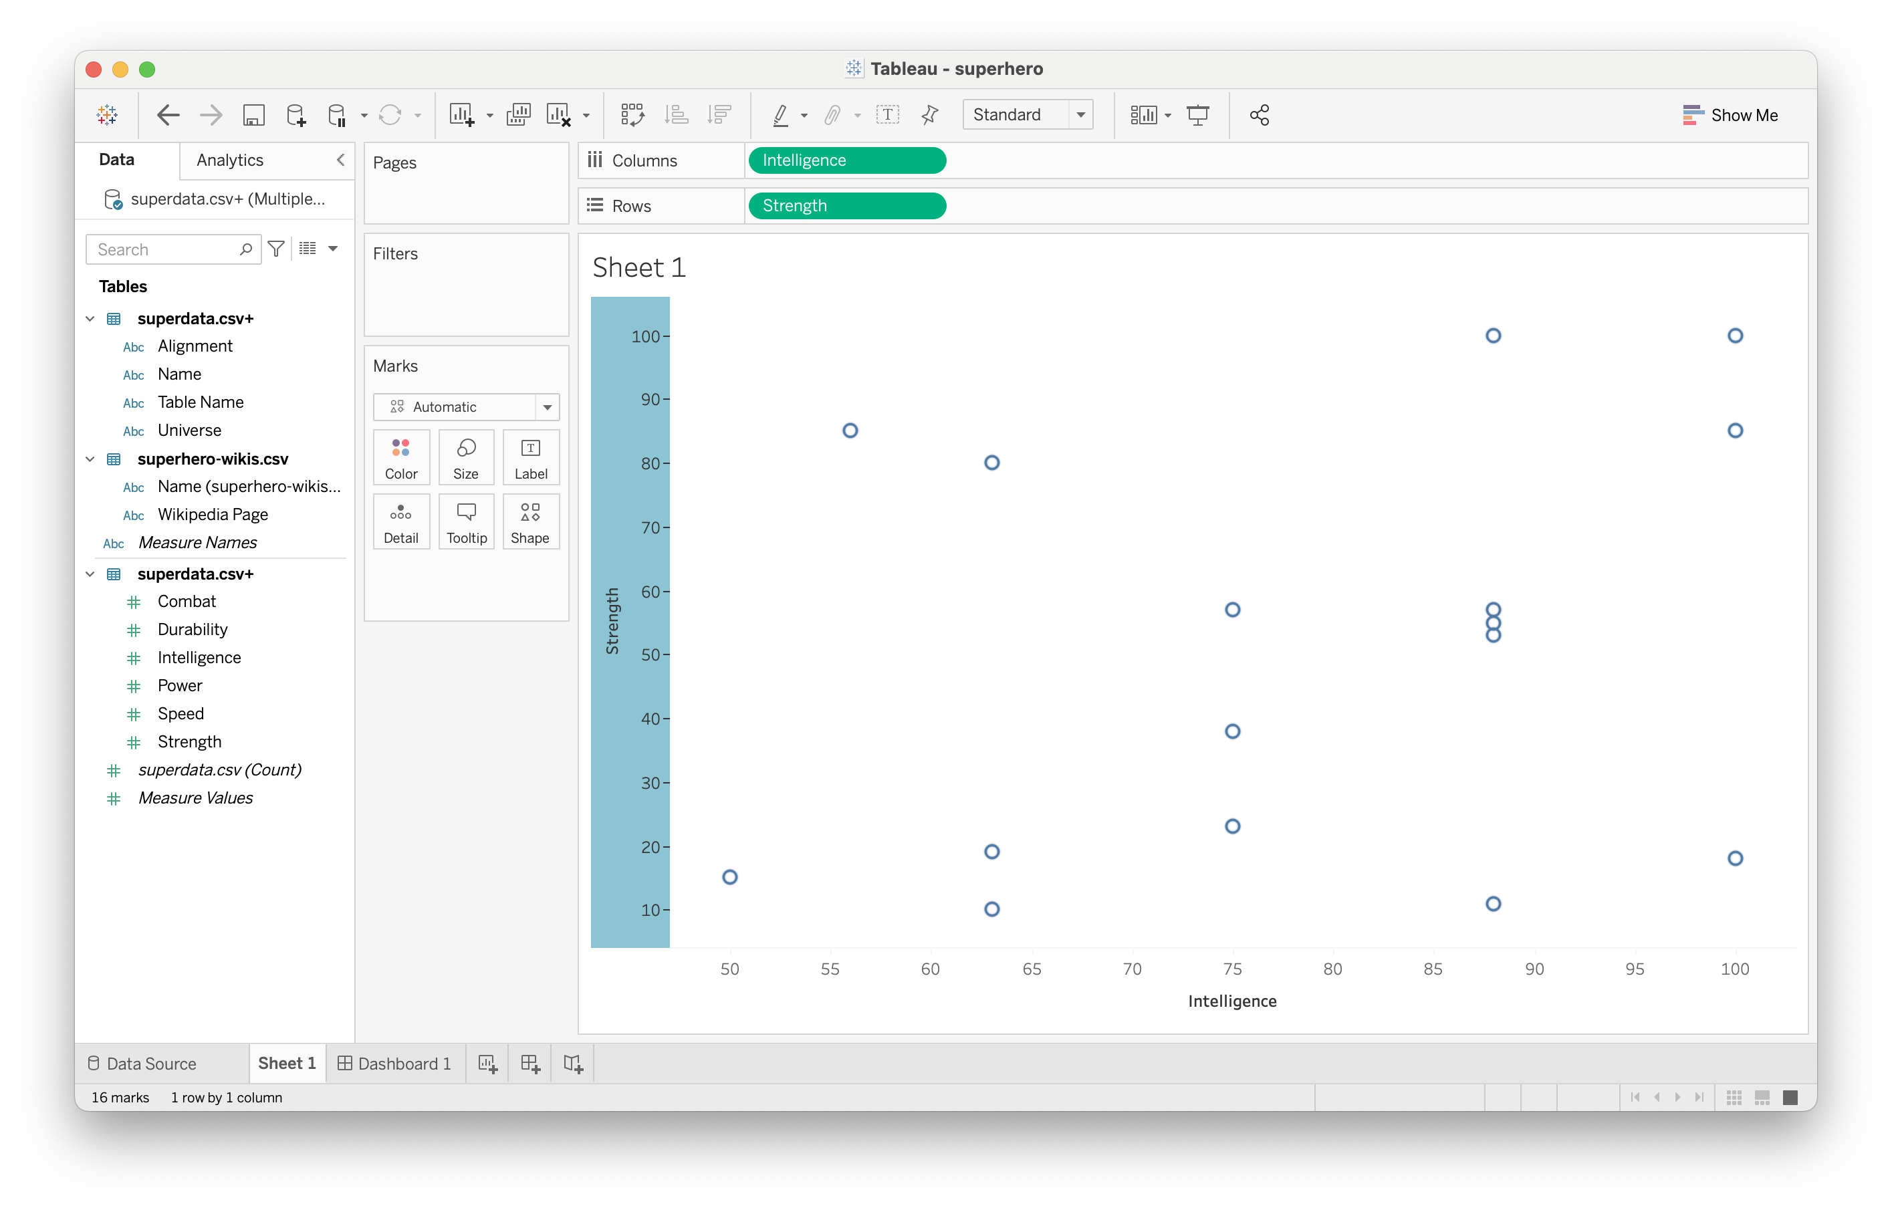
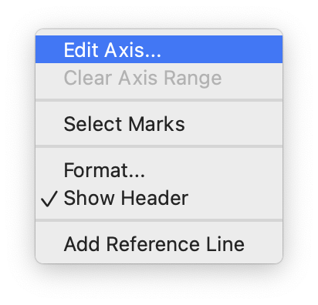
Editing axis values

Slide 17
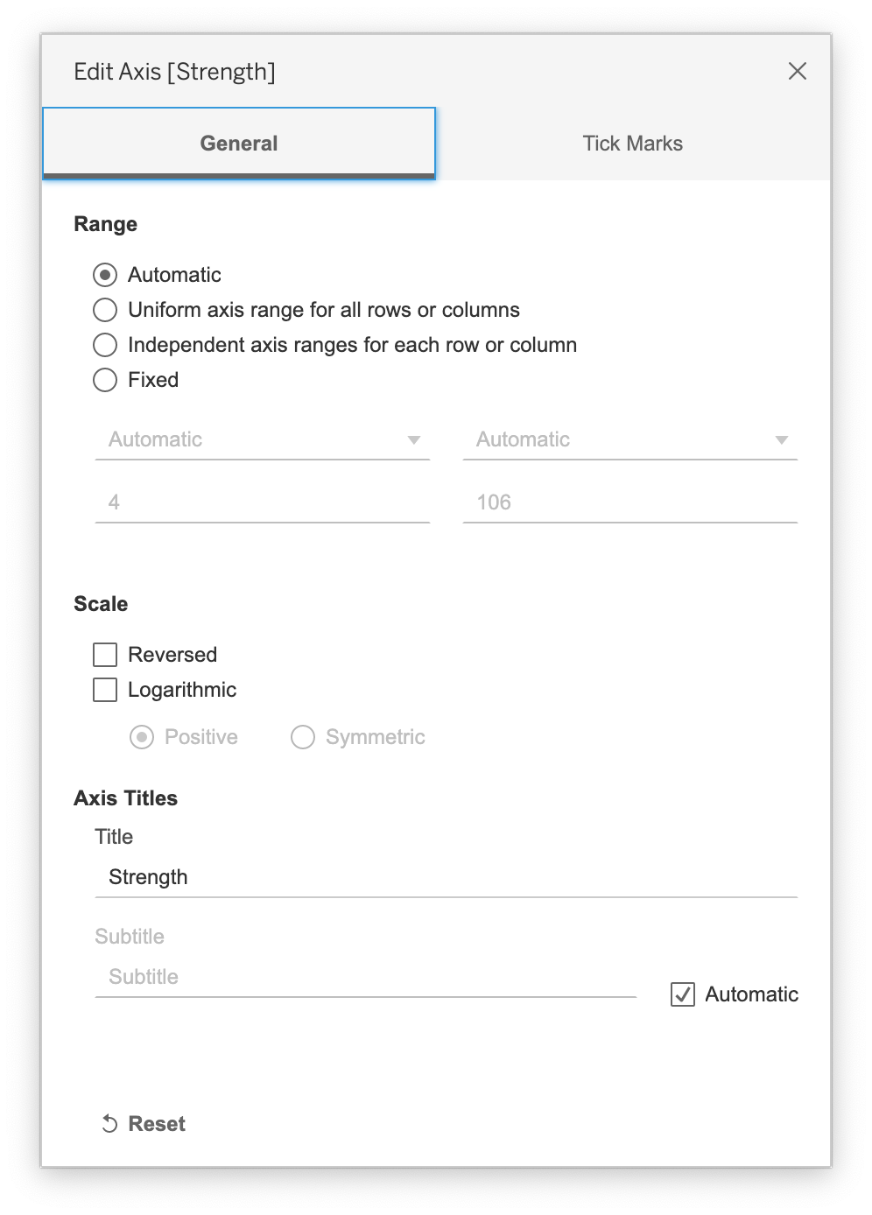
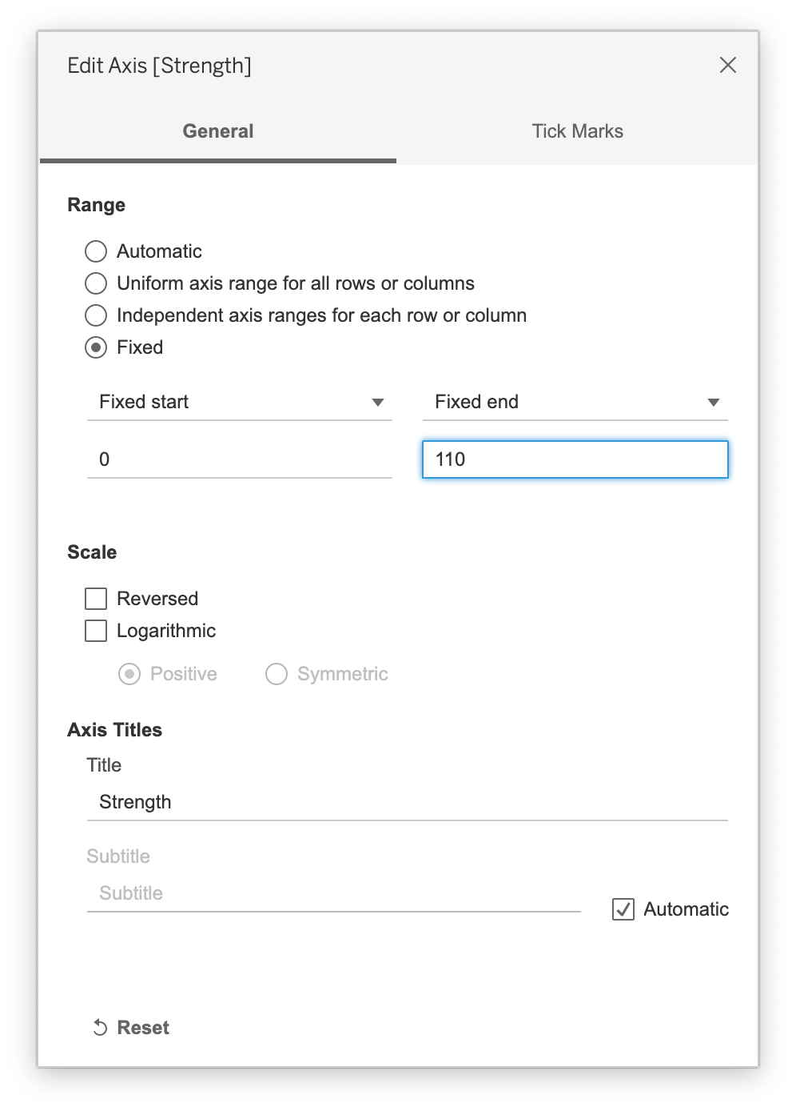
Editing axis values

Slide 18

Editing axis values

Slide 19
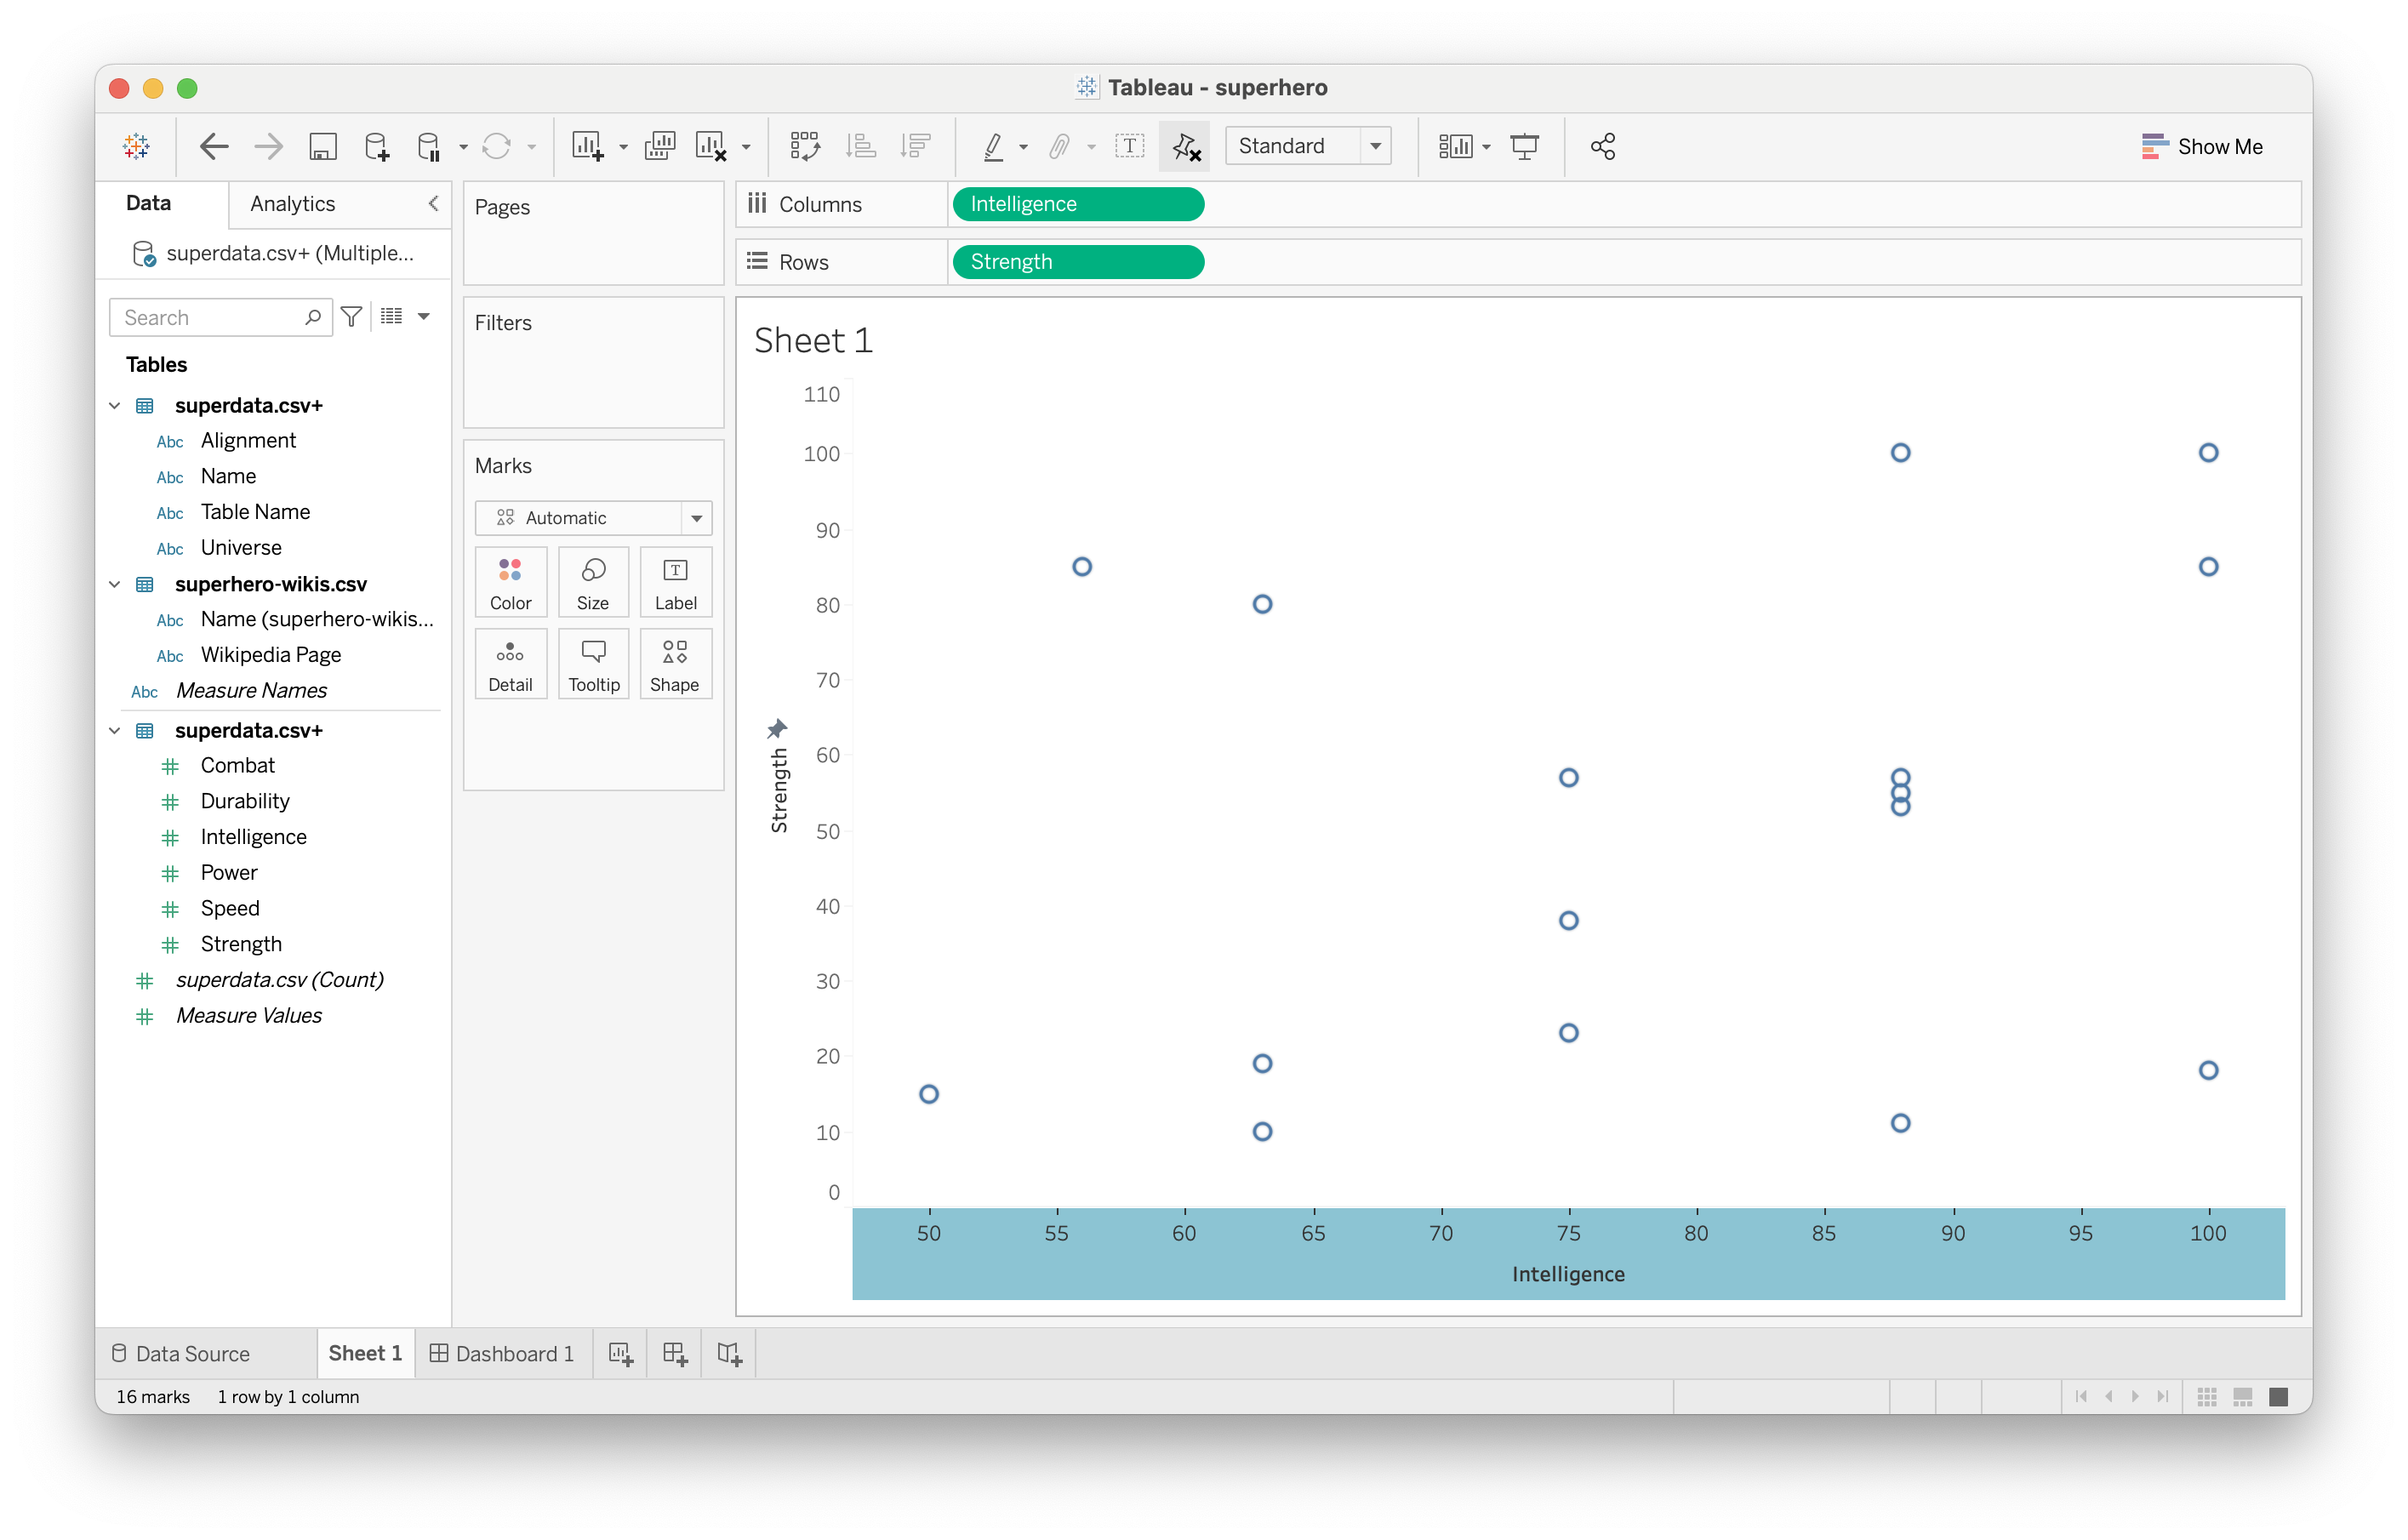
Editing axis values

Slide 20

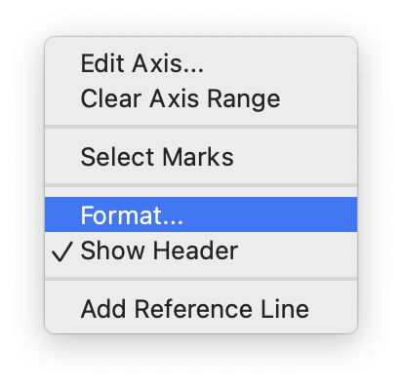
Format axis title

Slide 21
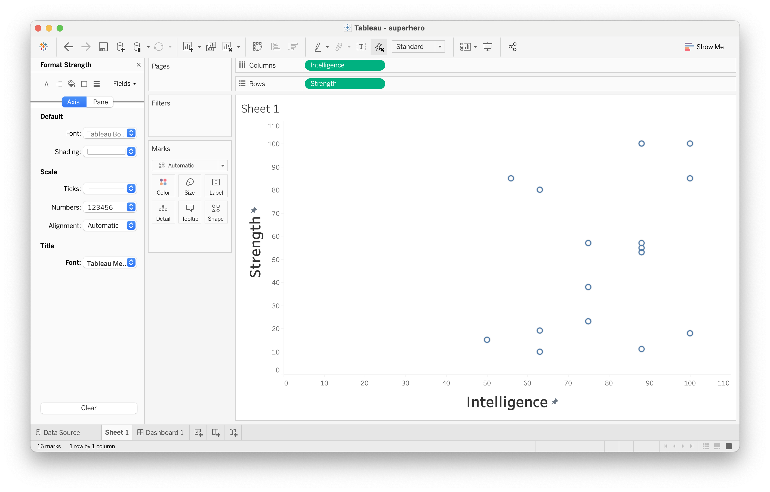
Format axis title

Slide 22

More interesting tooltips

Slide 23
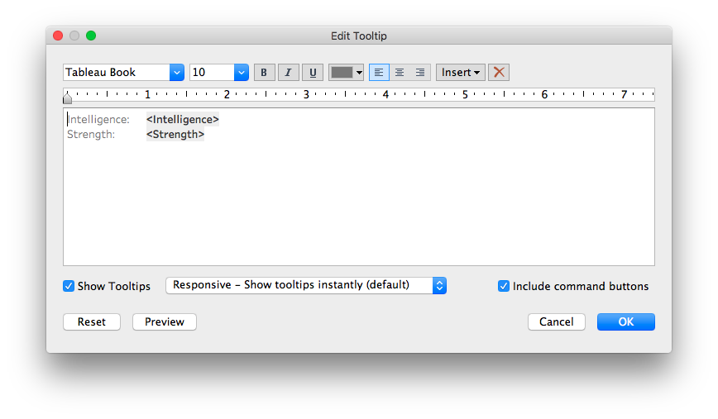
More interesting tooltips

Slide 24
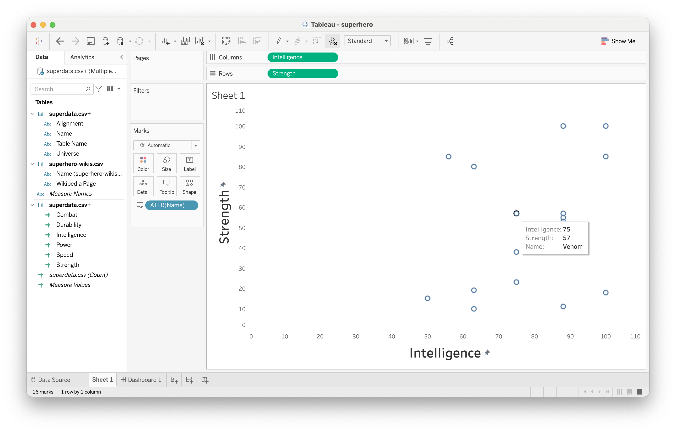
More interesting tooltips

Slide 25
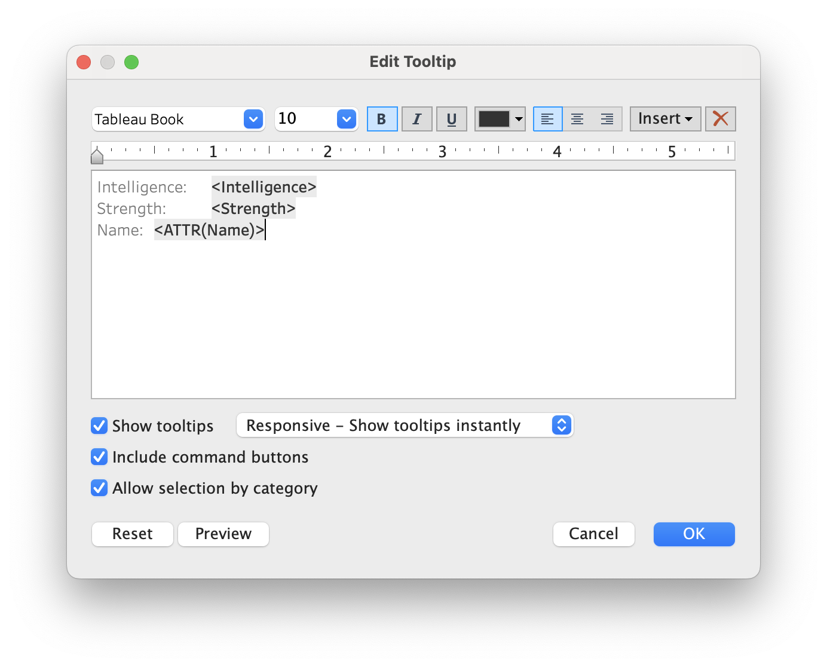
More interesting tooltips

Slide 26
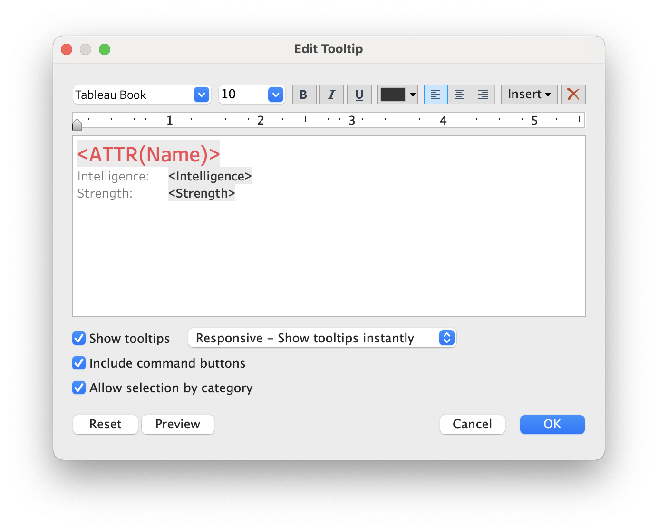
More interesting tooltips

Slide 27

More interesting tooltips

Slide 28
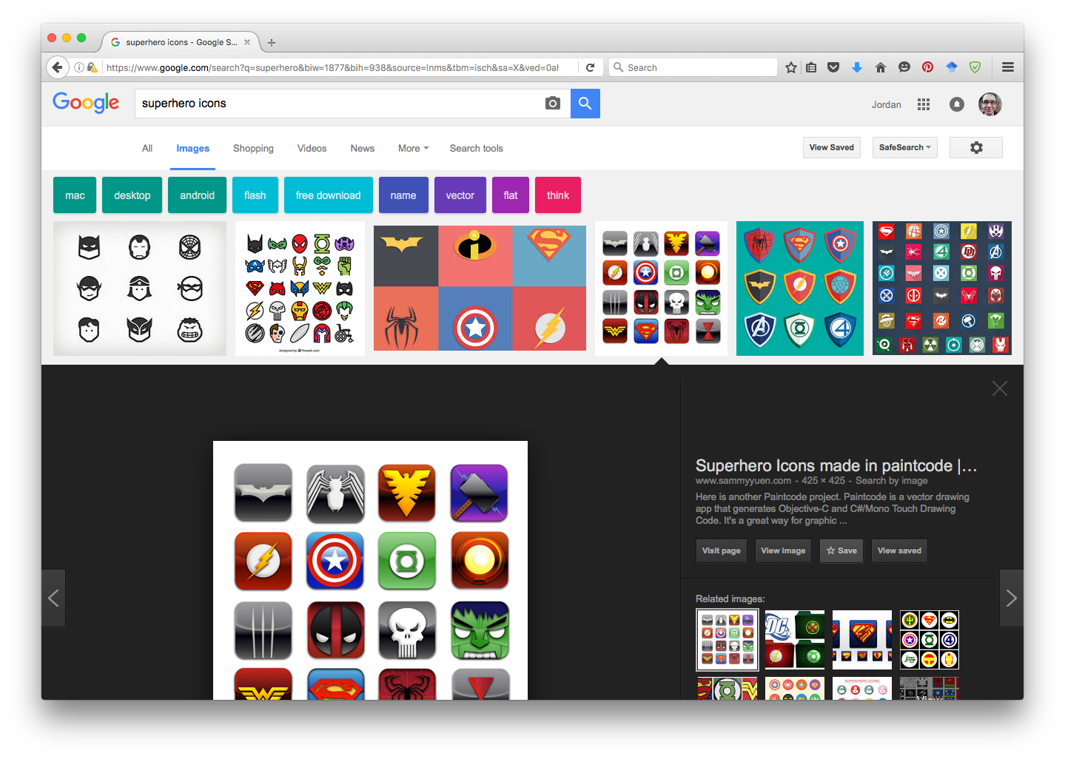
Adding custom shapes

Slide 29
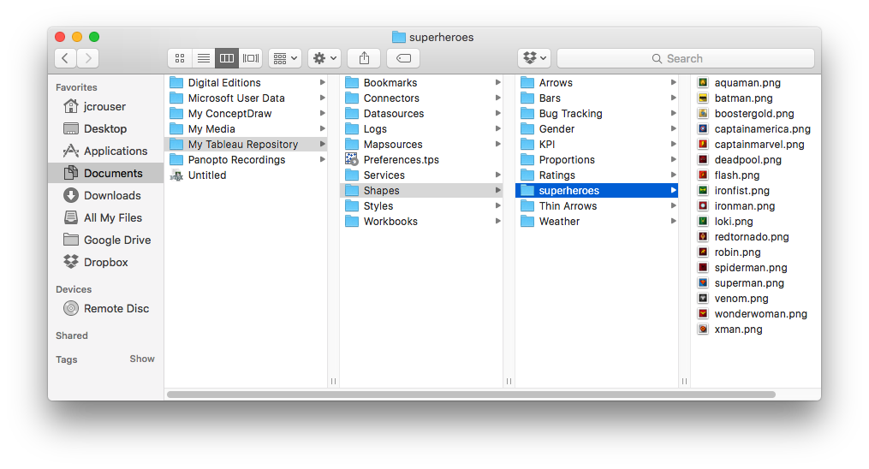
Adding custom shapes

Slide 30
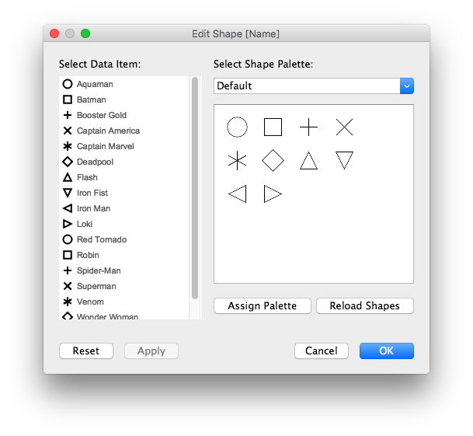
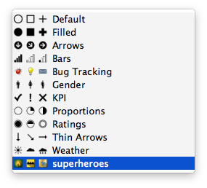
Adding custom shapes

Slide 31
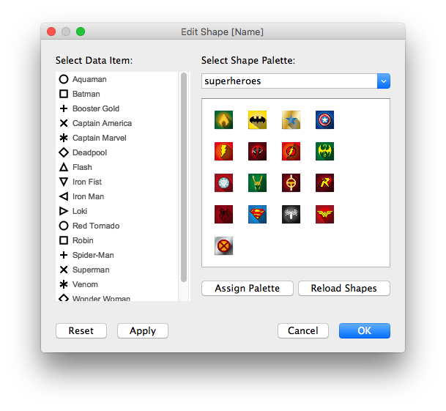
Adding custom shapes

Slide 32
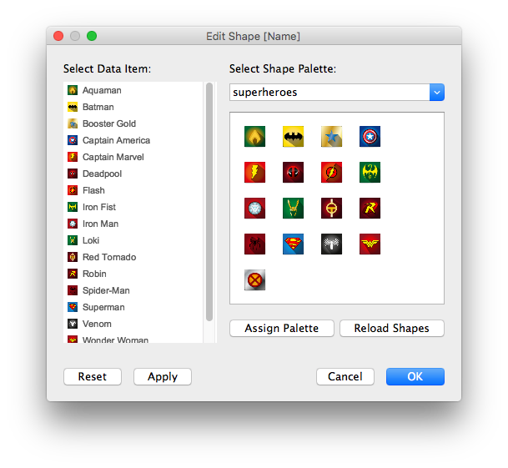
Adding custom shapes

Slide 33
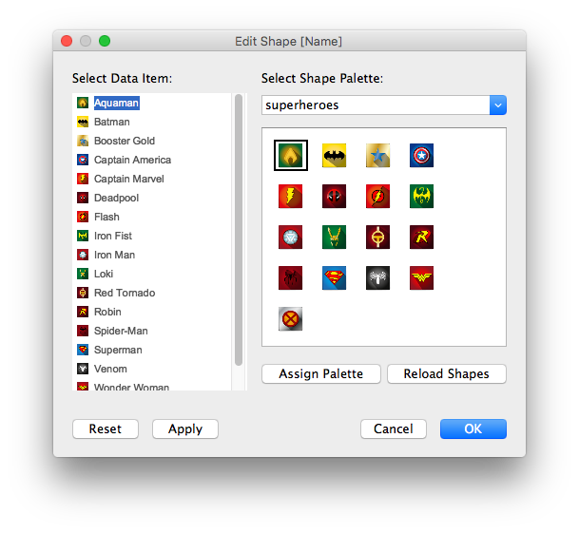
Adding custom shapes

Slide 34
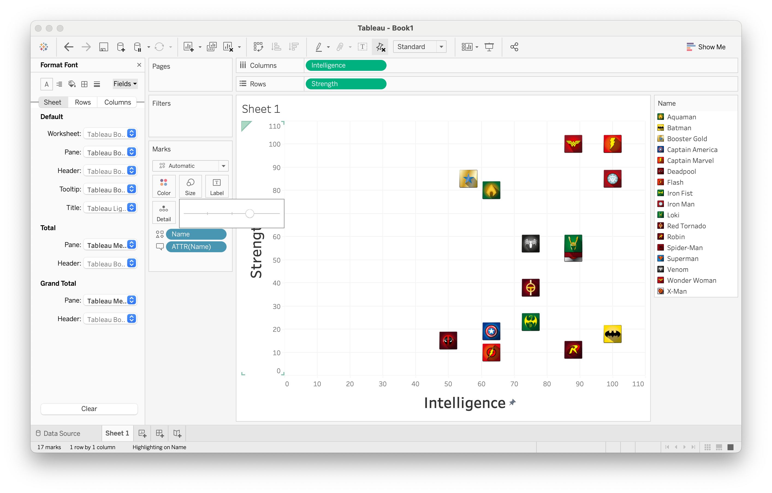
Scatterplot with custom shapes

Slide 35
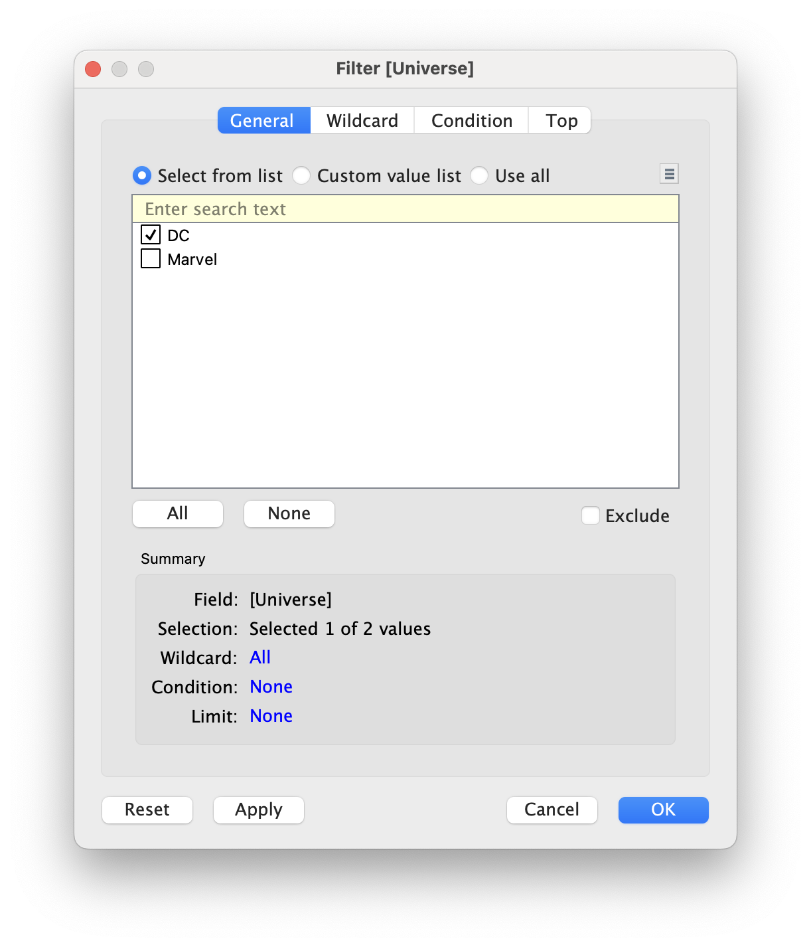
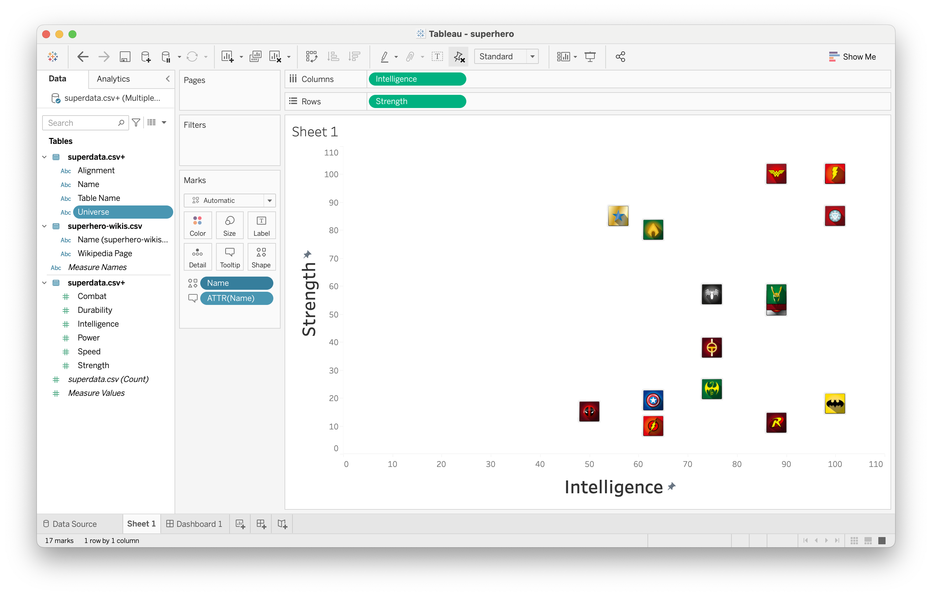
Working with filters

Slide 36
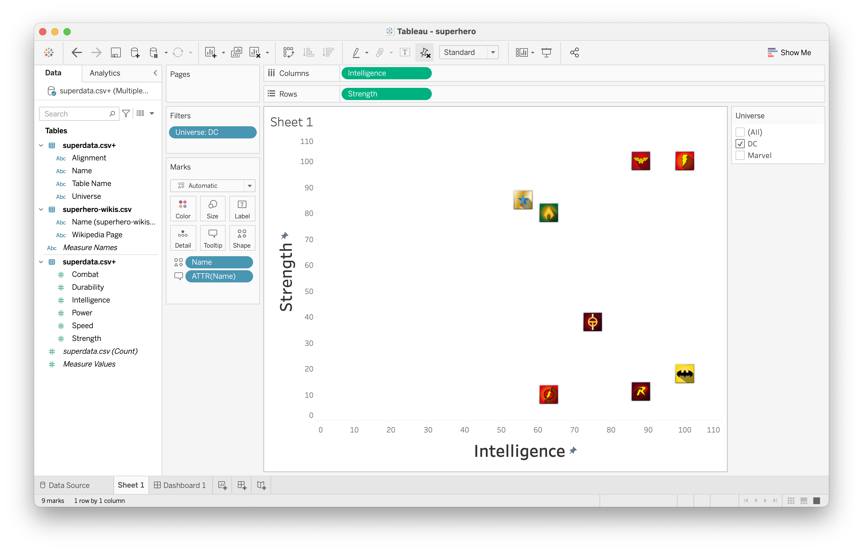
Working with filters

Slide 37
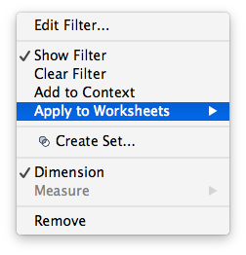
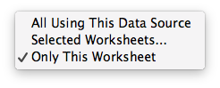
Changing a filter’s scope

Slide 38
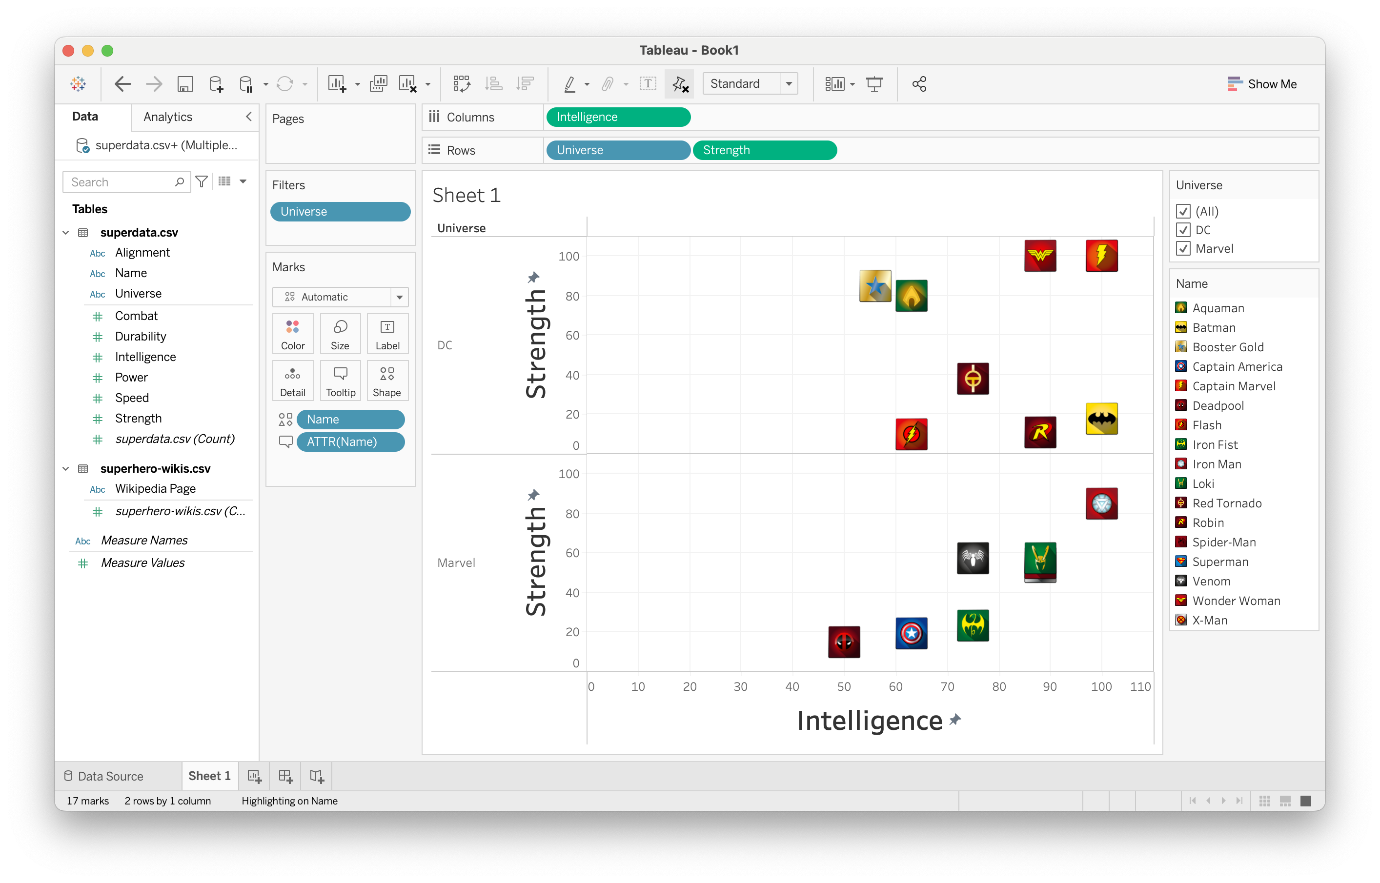
Implicit filtering (side-by-side comparison)

Slide 39


Adding background images

Slide 40
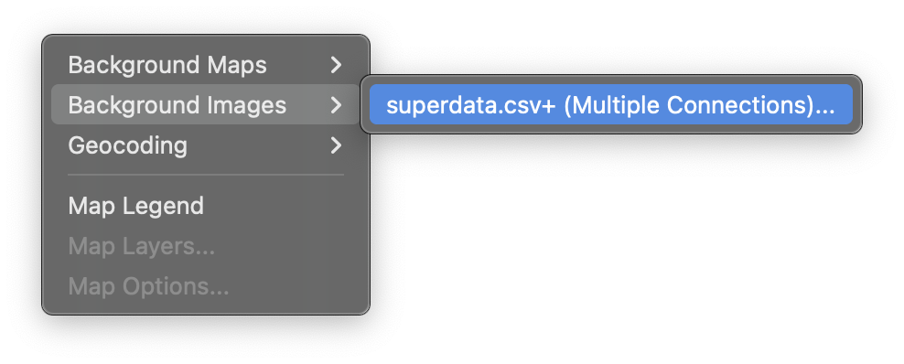
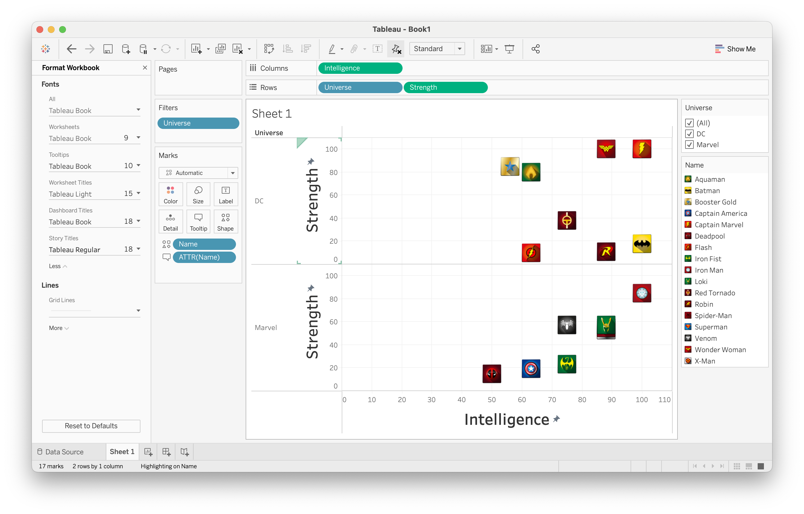
Adding background images

Slide 41
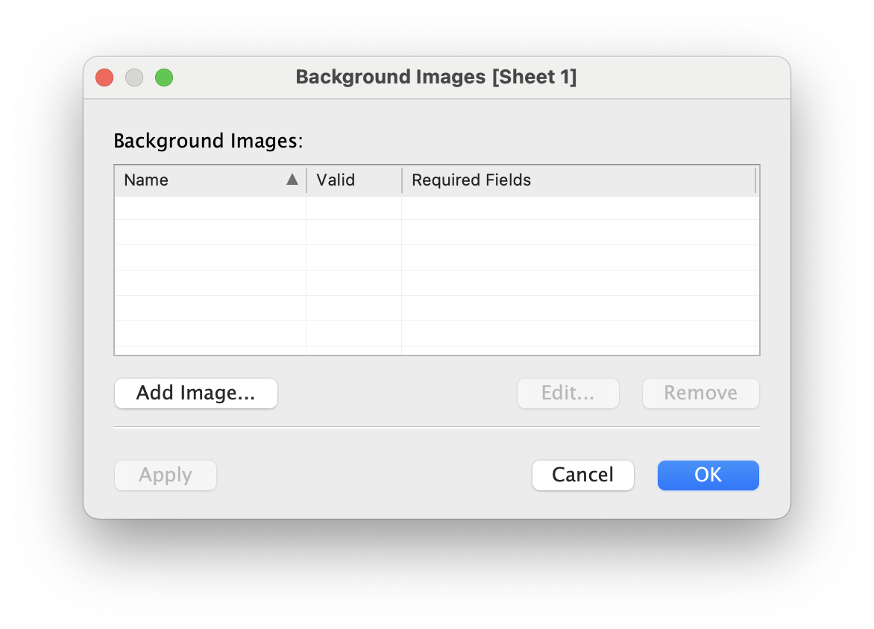
Adding background images

Slide 42
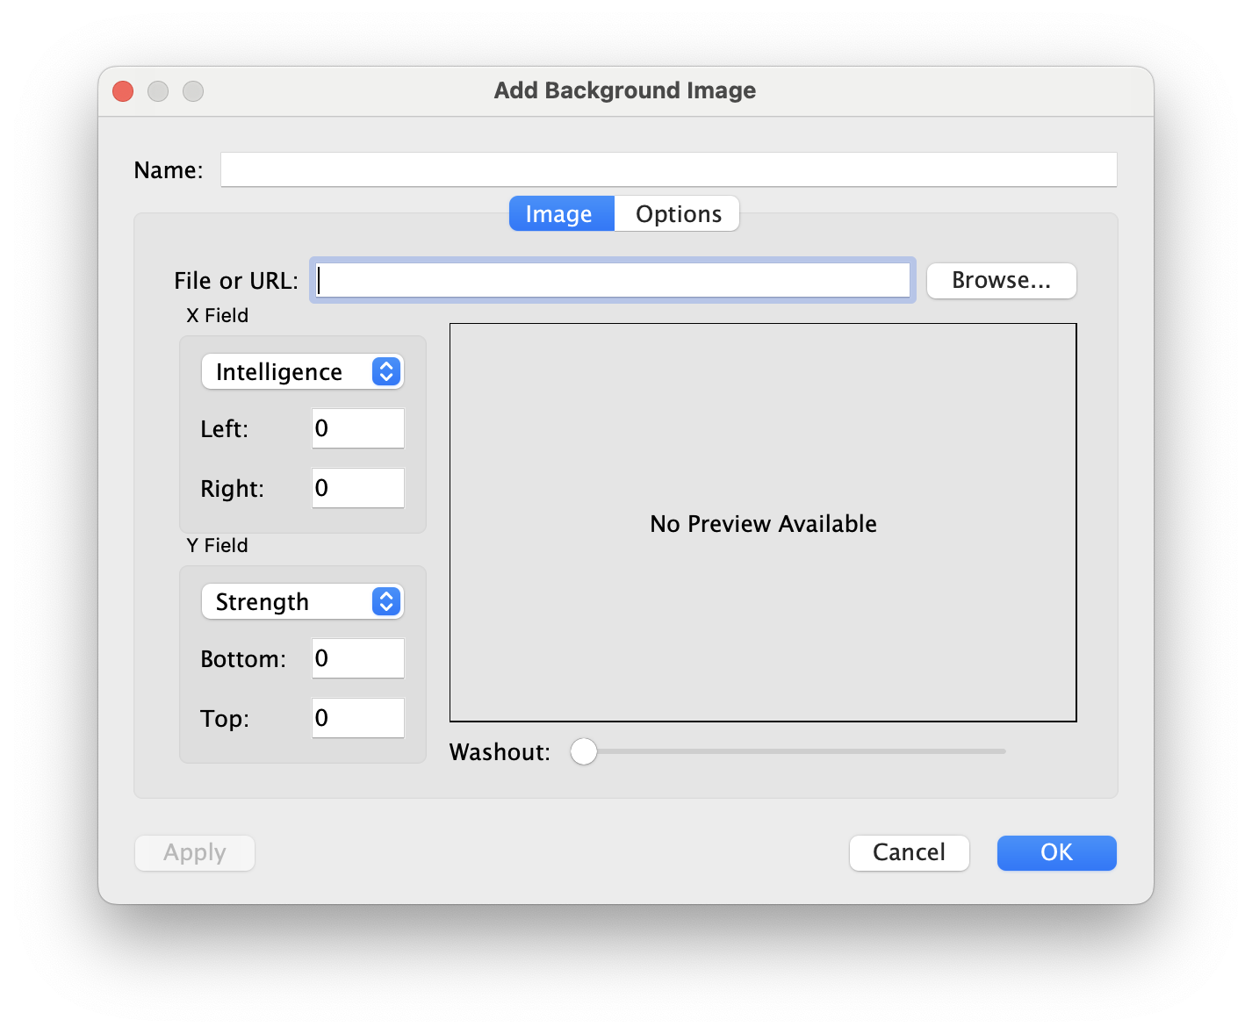
Adding background images

Slide 43
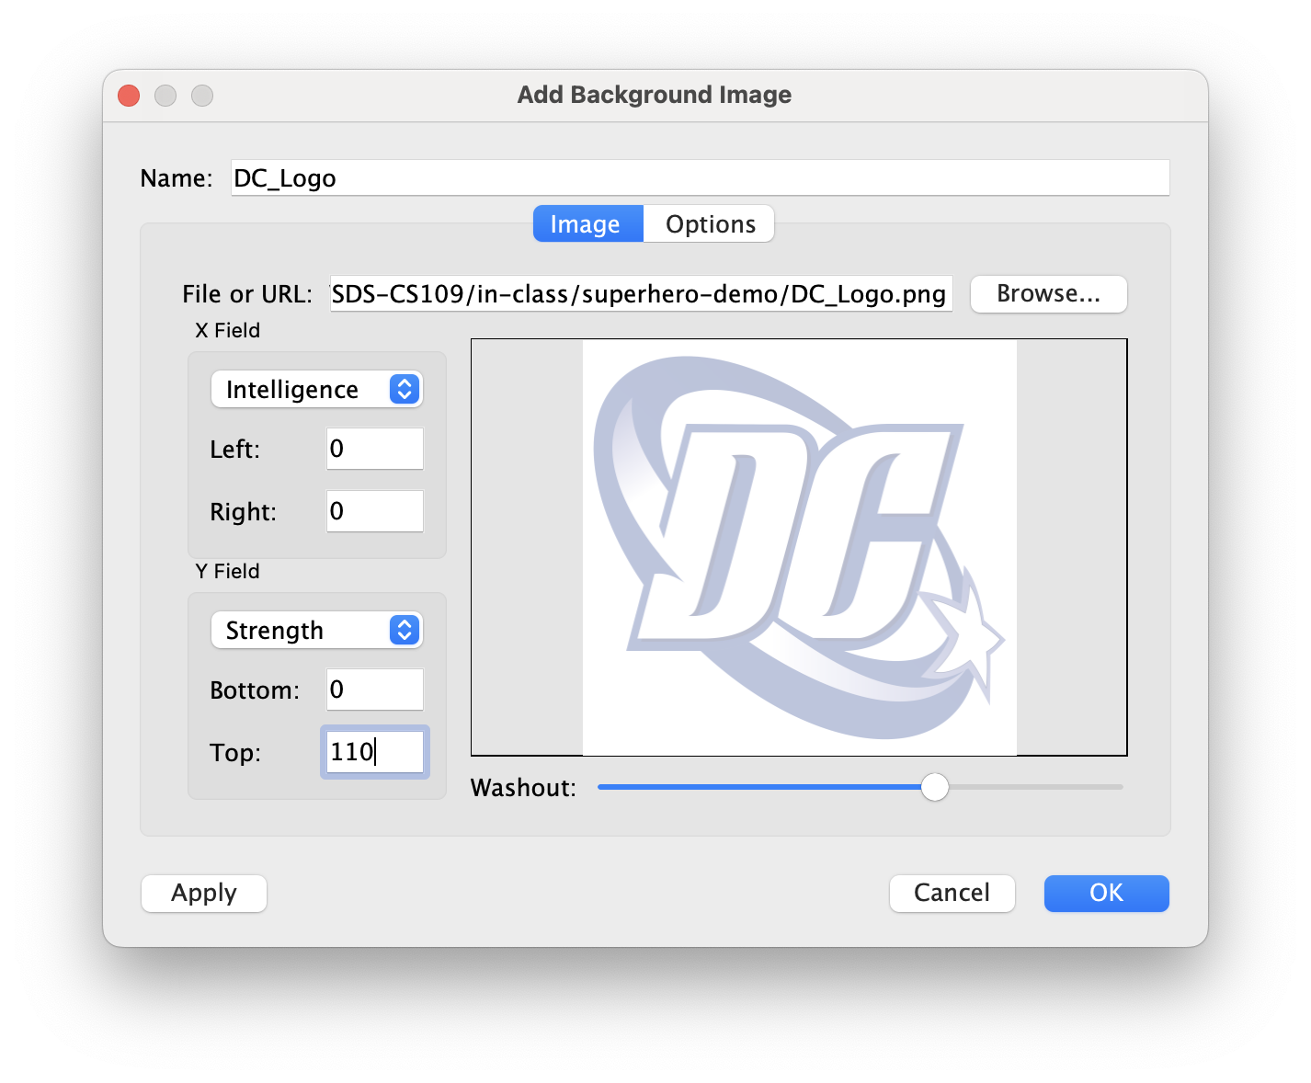
Adding background images

Slide 44
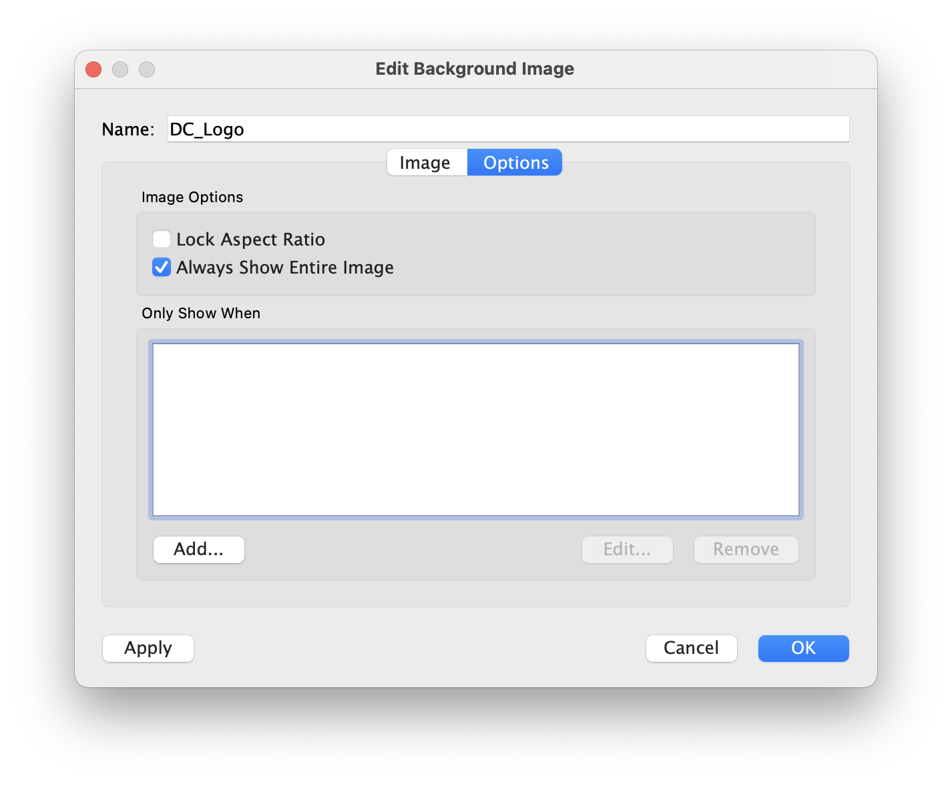
Adding background images

Slide 45
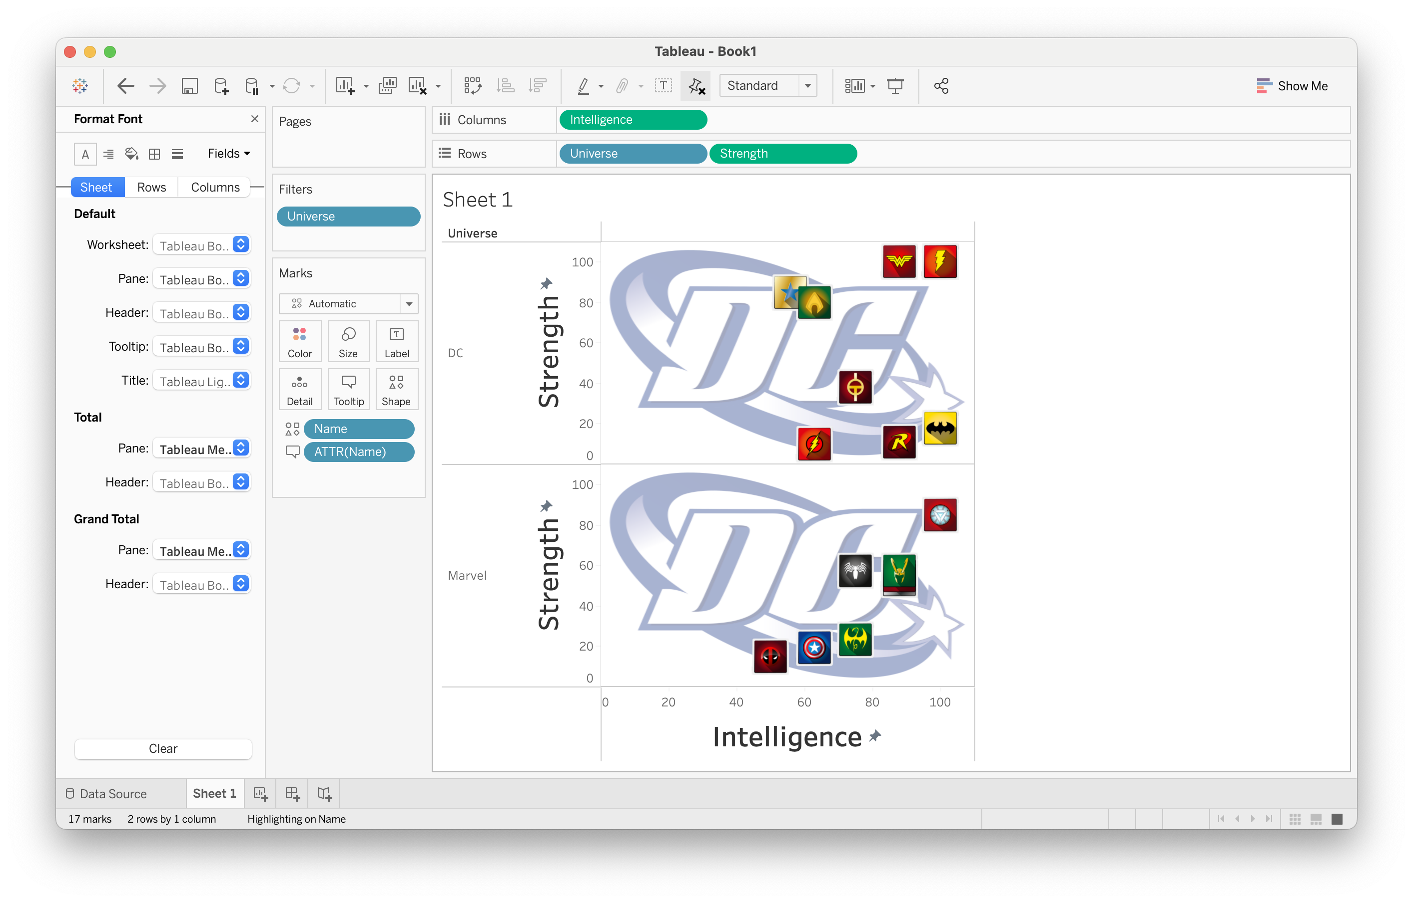
Adding background images

Slide 46
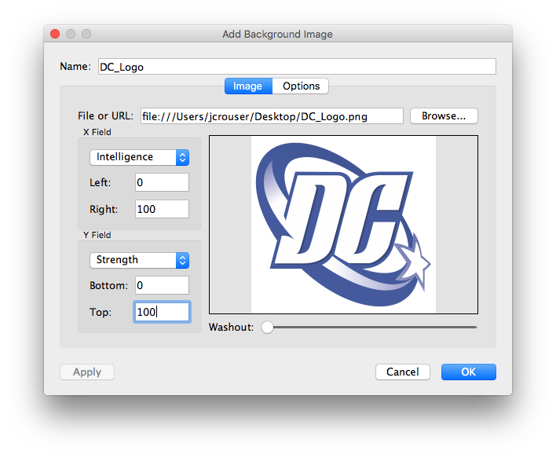
Adding background images

Slide 47
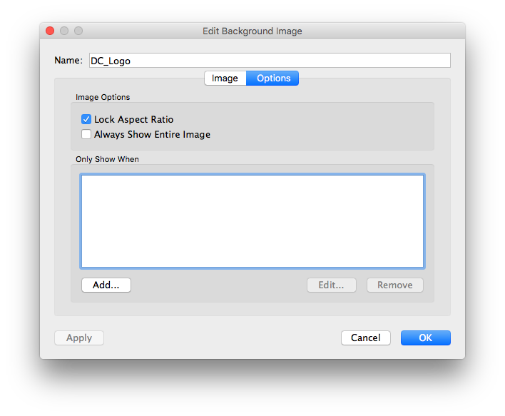
Adding background images

Slide 48
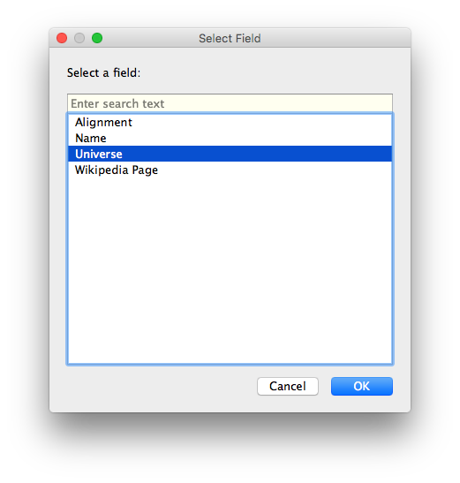
Adding background images

Slide 49
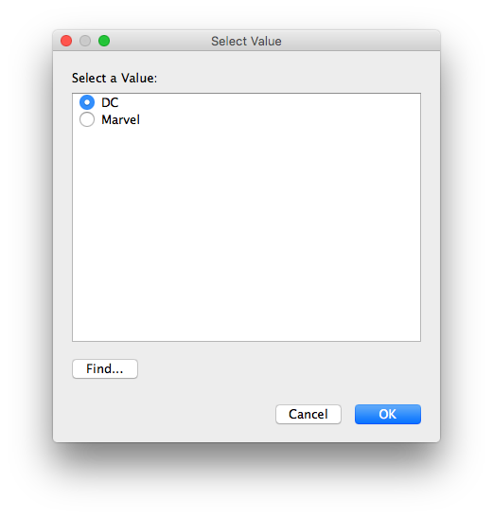
Adding background images

Slide 50

Adding background images

Slide 51

Adding background images

Slide 52

Adding background images

Slide 53

Adding background images

Slide 54

Customizing a dashboard

Slide 55
Customizing a dashboard

Slide 56

Customizing a dashboard

Slide 57

Customizing a dashboard

Slide 58

Flashback: dataset

Slide 59

Load external data on click

Slide 60

Load external data on click

Slide 61

Load external data on click

Slide 62

Load external data on click

Slide 63

Load external data on click

Slide 64


Load external data on click

Slide 65


Load external data on click

Slide 66

Load external data on click

Slide 67

Load external data on click

Slide 68


Load external data on click

Slide 69
Find your final project group. Brainstorm how you can incorporate at least two of the skills you learned today into your final project.
Your Turn!

